Slide 1
Life Expectancy Analysis
Presented by: Ashok Nagar
Tools: Python, Pandas, Seaborn, Matplotlib

Slide 2
Problem Description
Objective:
Understand factors affecting life expectancy across countries.
Compare life expectancy between developed and developing countries.
Explore relationships with socio-economic and health indicators.

Slide 3
Key Insights
1. Socio-economic factors like schooling and resource allocation strongly improve life expectancy.
2. High under-five and adult mortality significantly reduce life expectancy.
3. Developed countries have a consistent advantage, though developing countries are improving.
4. GDP increase is beneficial but with diminishing returns; investments should focus on health and education.
5. Immunization programs show positive impact, but effects vary by disease.

Slide 4
Conclusion & Recommendations
Conclusion:
Improving education, reducing child and adult mortality, and focusing on health infrastructure yield the largest gains in life expectancy.
Recommendations:
Invest in primary health care to lower under-five and adult mortality.
Enhance schooling and resource distribution equally across regions.
Support vaccination campaigns and targeted disease prevention.

Slide 5
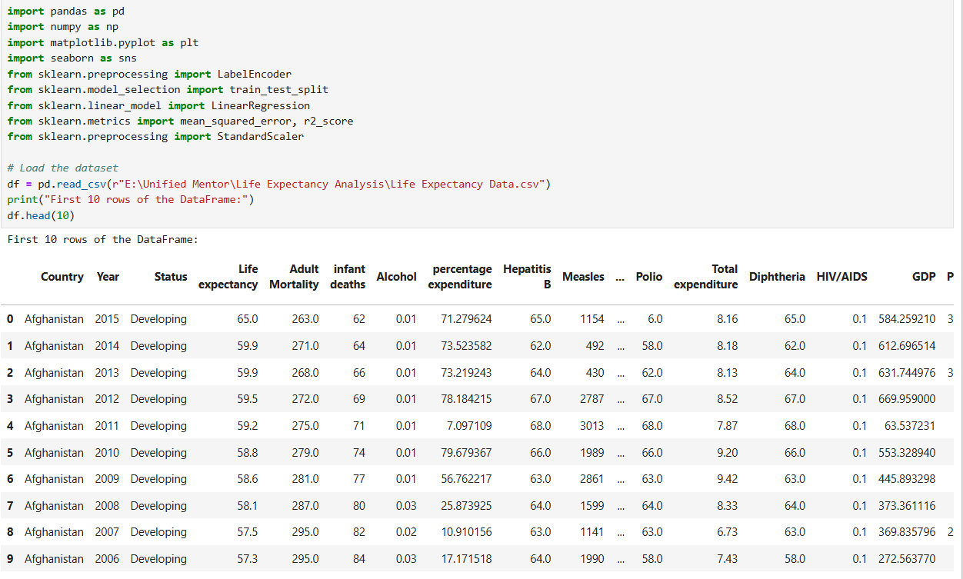
Python Code
Step 1: Data Collection - Load and inspect the dataset

Slide 6
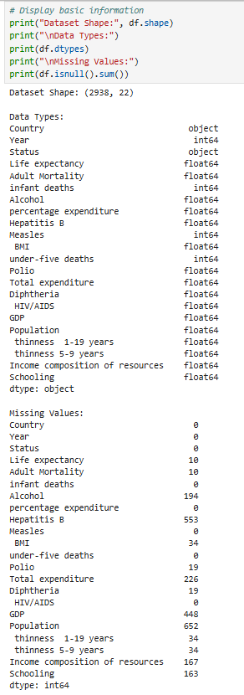

Slide 7
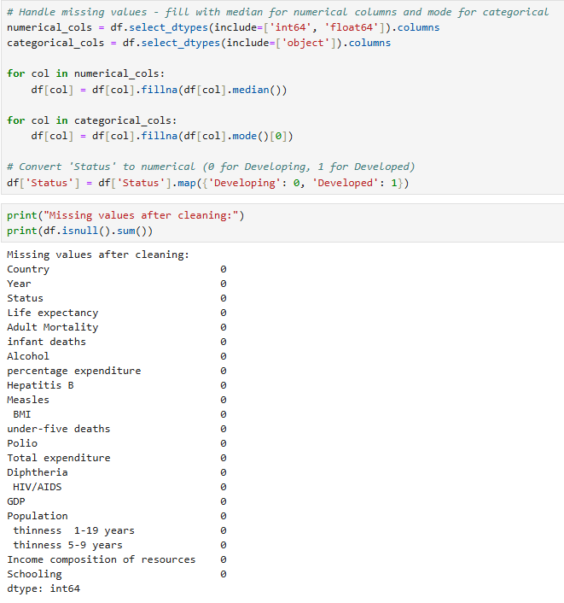
Step 2: Data Preprocessing

Slide 8
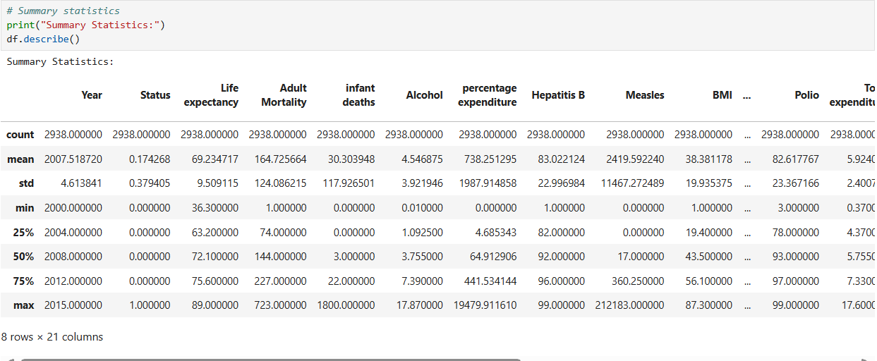
Step 3: Exploratory Data Analysis (EDA)

Slide 9
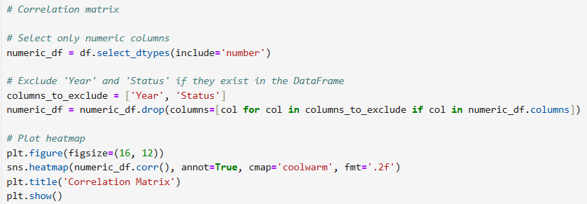
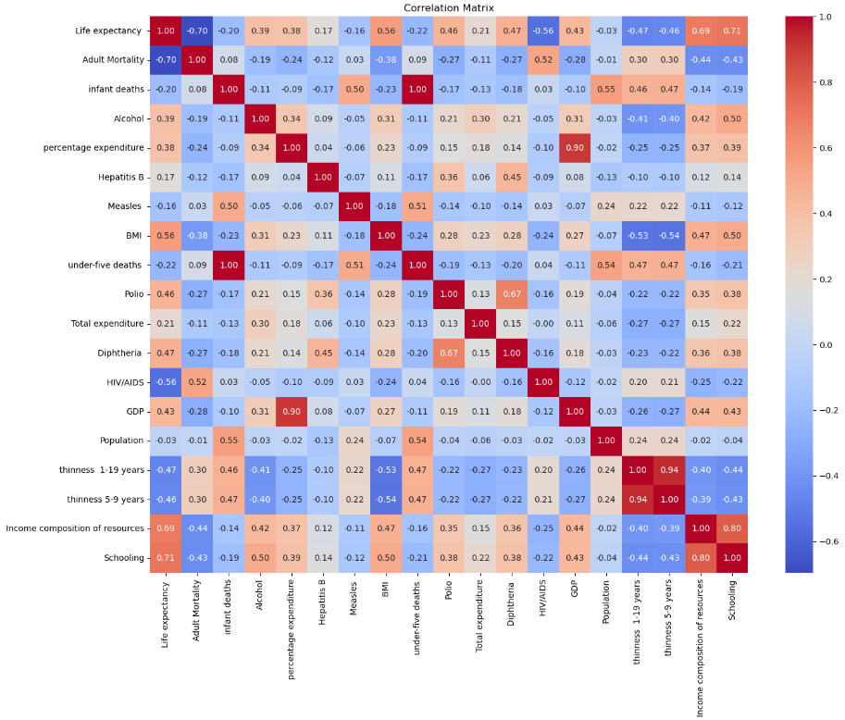

Slide 10
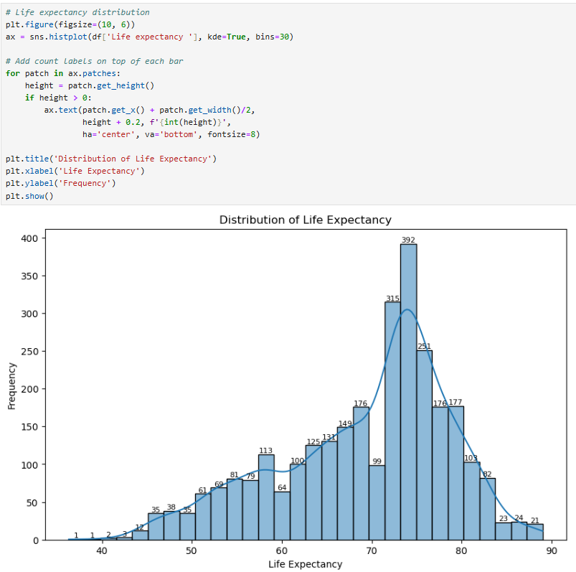

Slide 11
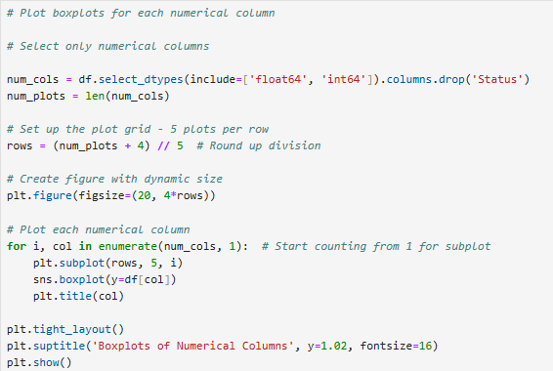
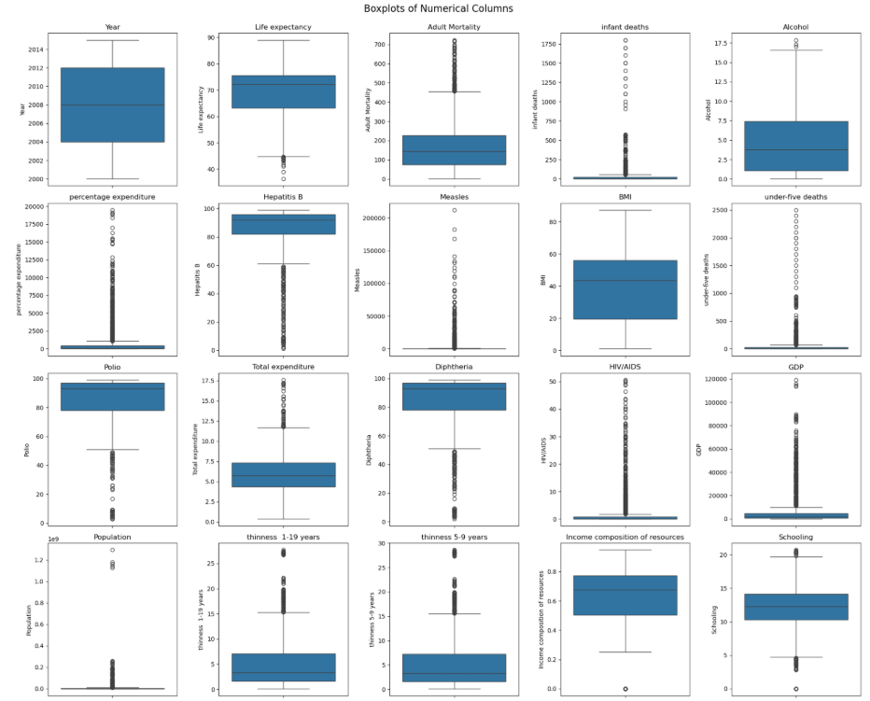

Slide 12
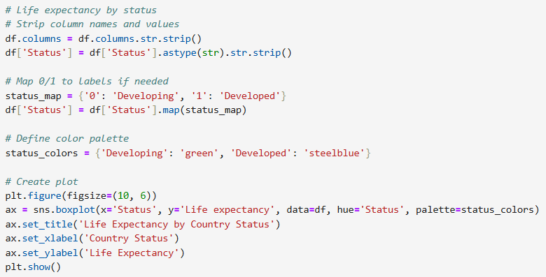
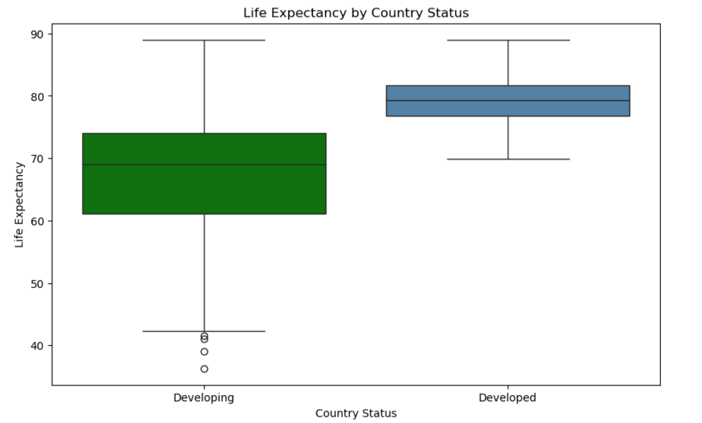

Slide 13
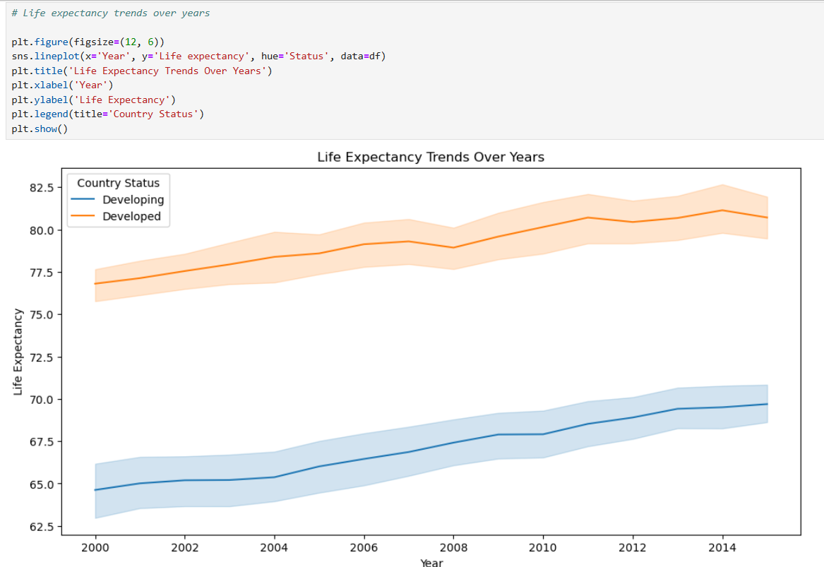

Slide 14
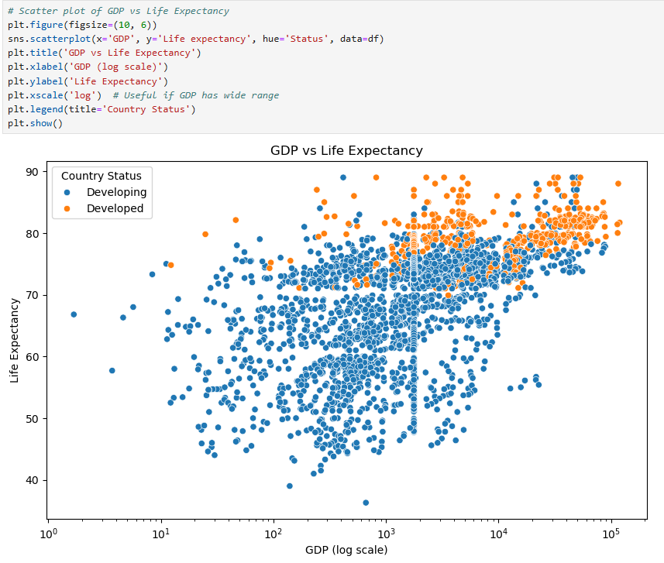
Step 5: Visualization (continued from EDA)

Slide 15
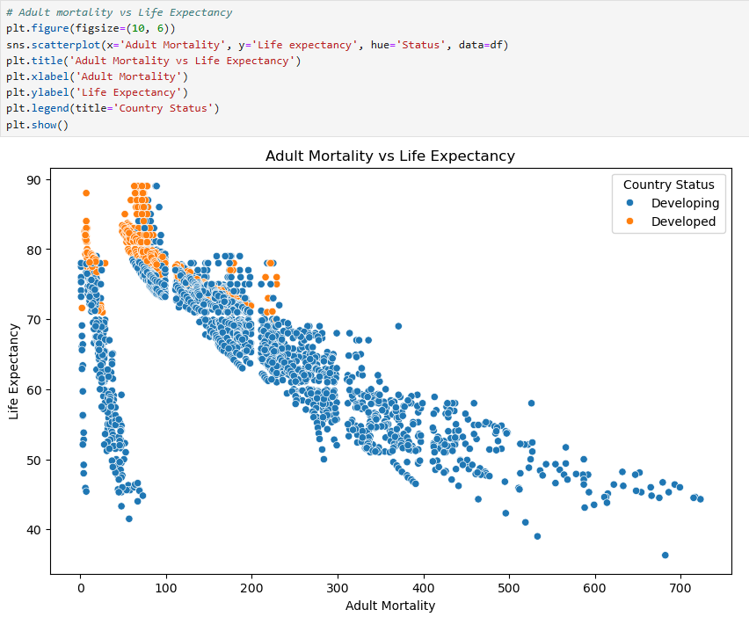

Slide 16
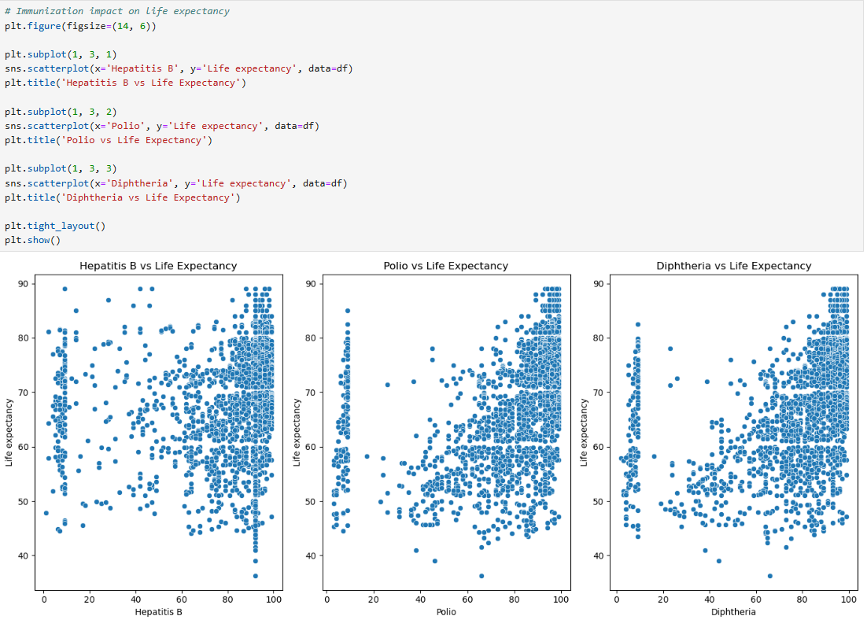

Slide 17
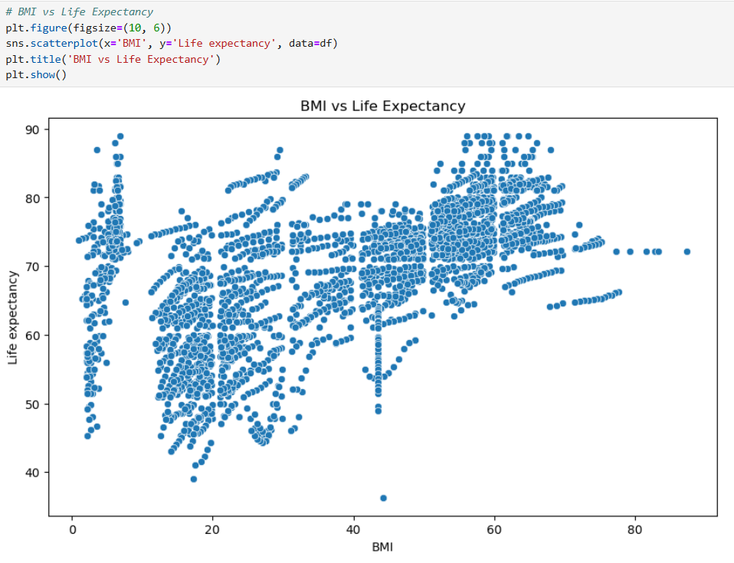

Slide 18
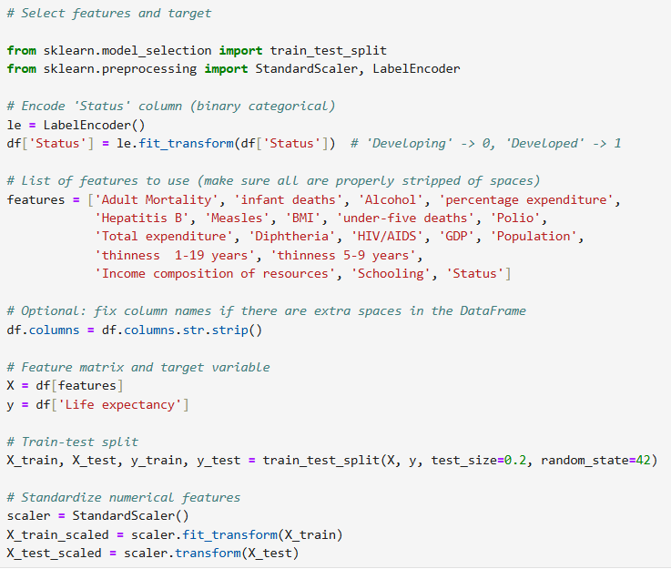

Slide 19
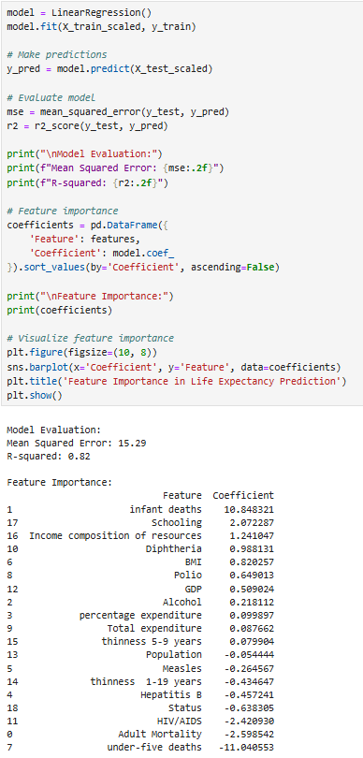
Step 7: Train and evaluate a linear regression model

Slide 20
